Slide 1


CREDIT CARD Fraud Detection
Using Machine Learning
BANK
Prepped by :
Mais Alhennawi
Nada Nemr
Salam Alhaj
1856
5893
1287
8934
Supervisors :
DR. Moutasem Shafaamri
Eng. Anas Mokhalalati
CARD HOLDER NAME
09/22

Slide 2






Outlines :
A
01
Project idea and goals
07
Machine learning algorithms
02
Related works
08
Tools
03
Machine learning
09
Implementation
04
Machine learning in
security
10
Demo
05
Credit card fraud
detection
11
Difficulties and future
work
06
User data in dataset

Slide 3

01
Project idea and goals
A website to monitor the transaction by the admin
Detecting fraud in transactions
Interface for user monitor of his transactions
Send a notification to the user's e-mail in case of suspected fraud

Slide 4

02
Related works
01
A. Shen etal (2007)
02
M.J. Islam et al (2007)
03
Y. Sahin and E. Duman (2011)

Slide 5
03
Machine learning
1
2
3
4
5
Title 1
Title 2
Title 3
Title 4
Title 5
Get Data
Clean, prepare
& manipulated data
Train model
Test model
Generalization

Slide 6
04
Machine learning in security
Find threats on a network
OPTION 01
OPTION 02
Keep people safe when browsing
OPTION 03
Provide endpoint malware protection
OPTION 04
Protect data in the cloud

Slide 7

05
Credit card fraud
What is fraud in credit card ?
Type of fraud in credit card ?
How to detect credit card fraud ?

Slide 8




Machine learning
Artificial and Computationl intelligence
detect credit card fraud using technology
Neural Networks
Genetic Algorithms and A Range of Additional Algorithms

Slide 9

06
User data in dataset
Features

Slide 10
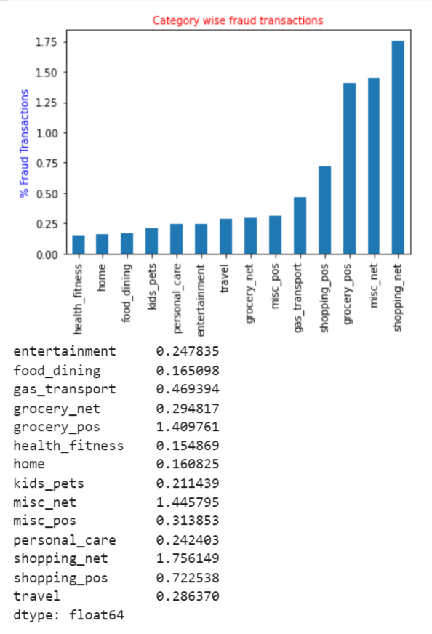
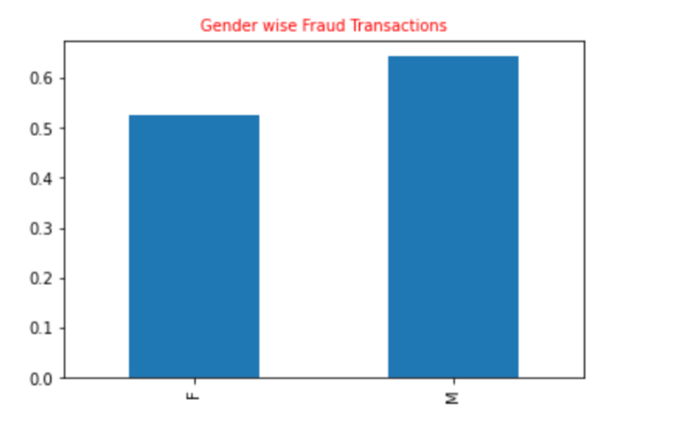
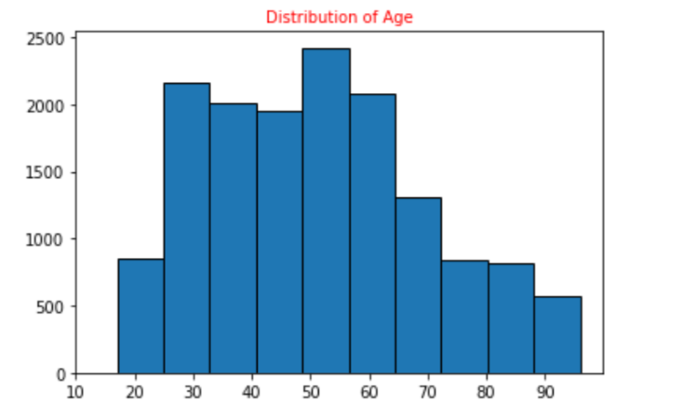
Features extraction

Slide 11
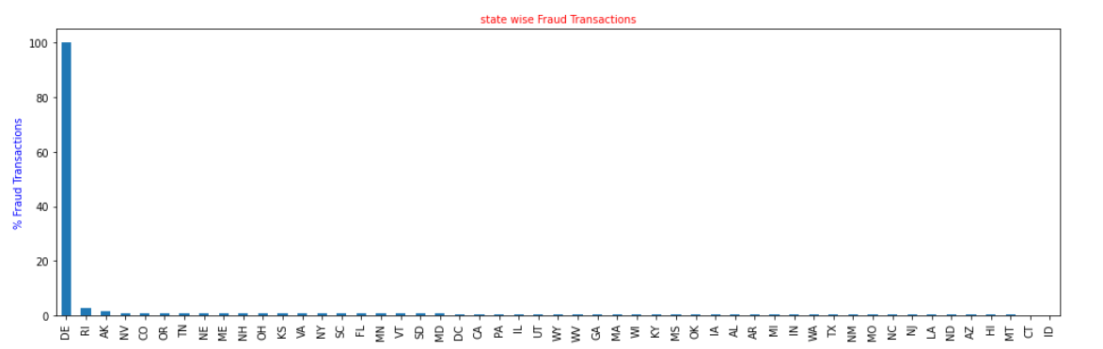

Slide 12
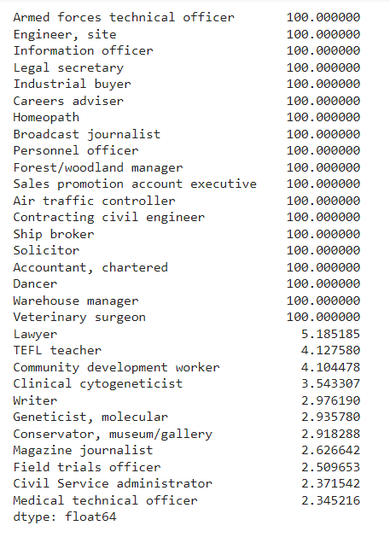
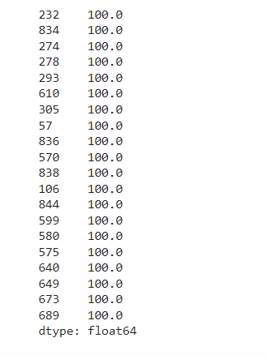
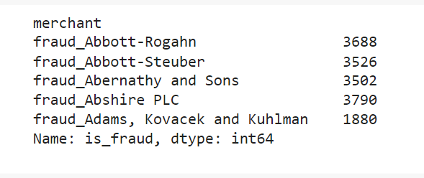

Slide 13

Preprocessing data
Why Data Preprocessing in Machine Learning ?
How was it implement in our project ?

Slide 14
07
Machine learning algorithms
stratified K fold
01
02
03
Under sampling
Over sampling
SMOTH (Over sampling)

Slide 15
Algorithms
1
2
3
4
5
Decision Tree
Random Forest
XGBClassifier
SVM
GaussianNB

Slide 16
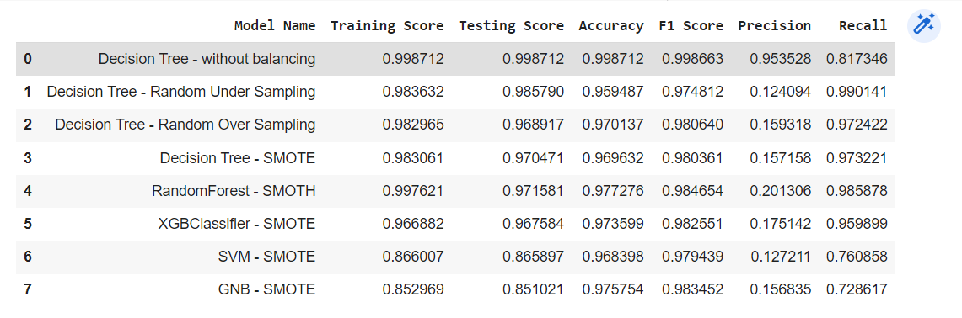
Choose the best algorithm
The first step
Confusion matrix :

Slide 17
The second step:
Cohen_kappa_score :
Model name | Cohen_kappa_score
Decision Tree - without balancing | 0.05
Decision Tree - Random Under Sampling | 0.24
Decision Tree - Random Over Sampling | 0.26
Decision Tree - SMOTE | 0.27
Random Forest - SMOTH | 0.35
XGBClassifier - SMOTE | 0.26
SVM - SMOTE | 0.20
GNB - SMOTE | 0.23

Slide 18




08
Tools

Slide 19
Python
Library
experimental
xgboost
SKlearn
model_selection
pandas
Tree
preprocessing
Joblib
ensemble
naive_bayes
sqlalchemy
svm
metrics

Slide 20

Flask
Why is Flask a good web framework choice?
Flask REST API

Slide 21
Streamlit
What is Streamlit?
Why Streamlit?
deploy and share your

Slide 22
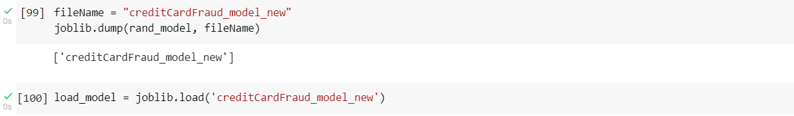
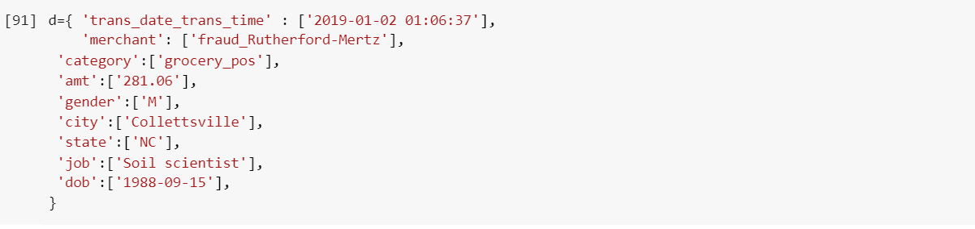
09
Implementation
Model output
Inputs

Slide 23
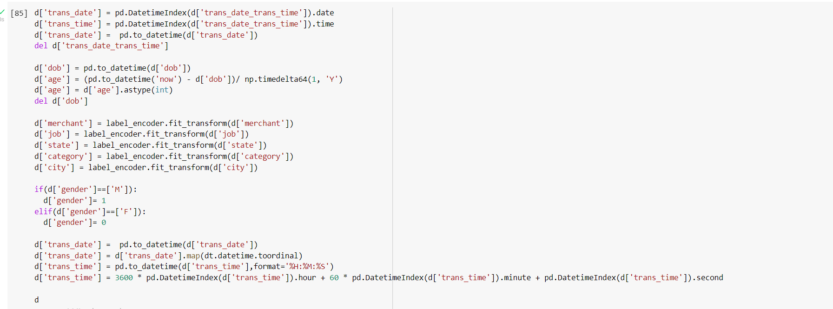
Preprocessing Data

Slide 24
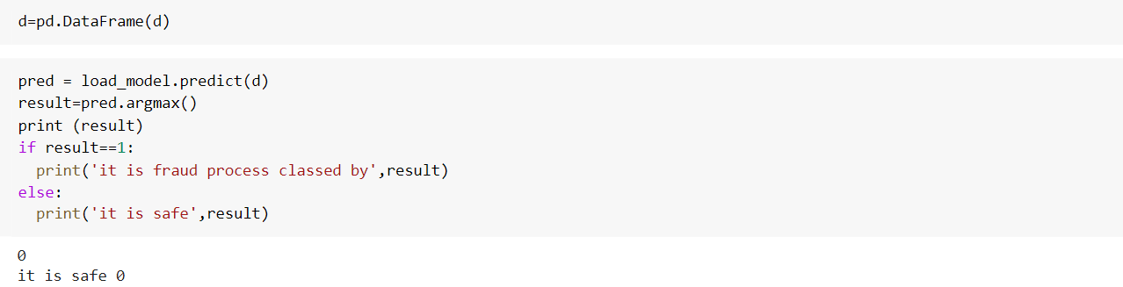

Output

Slide 25




Website
Admin Dashboard and User interface
Used Techniques

Slide 26
Integration of interfaces with backend and the model
We are going to use Laravel and streamlit to make Credit card fraud detection web page and we are going to use Laravel and flask for backend

Slide 27
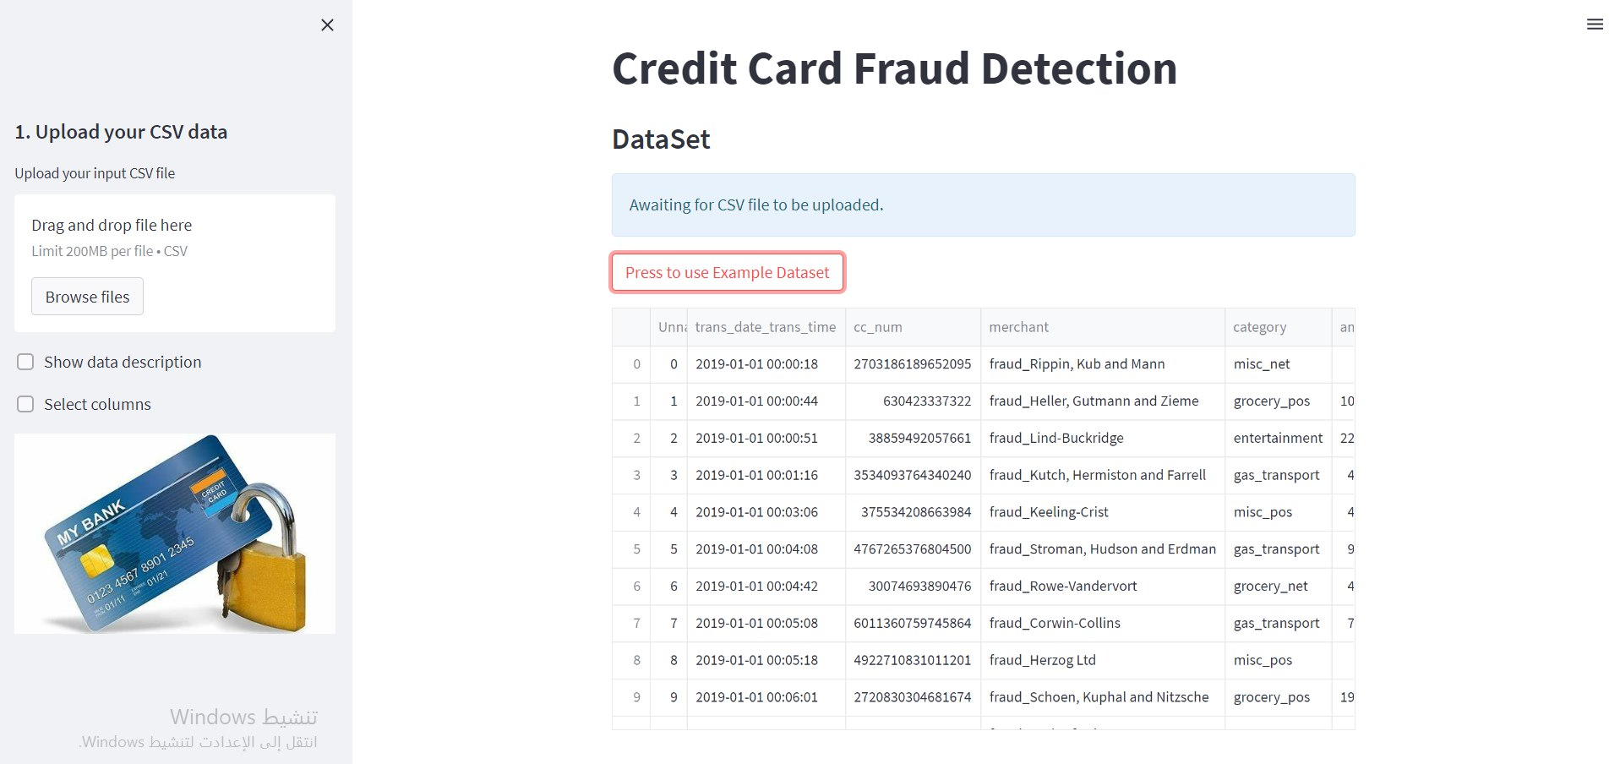
10
StreamLit

Slide 28
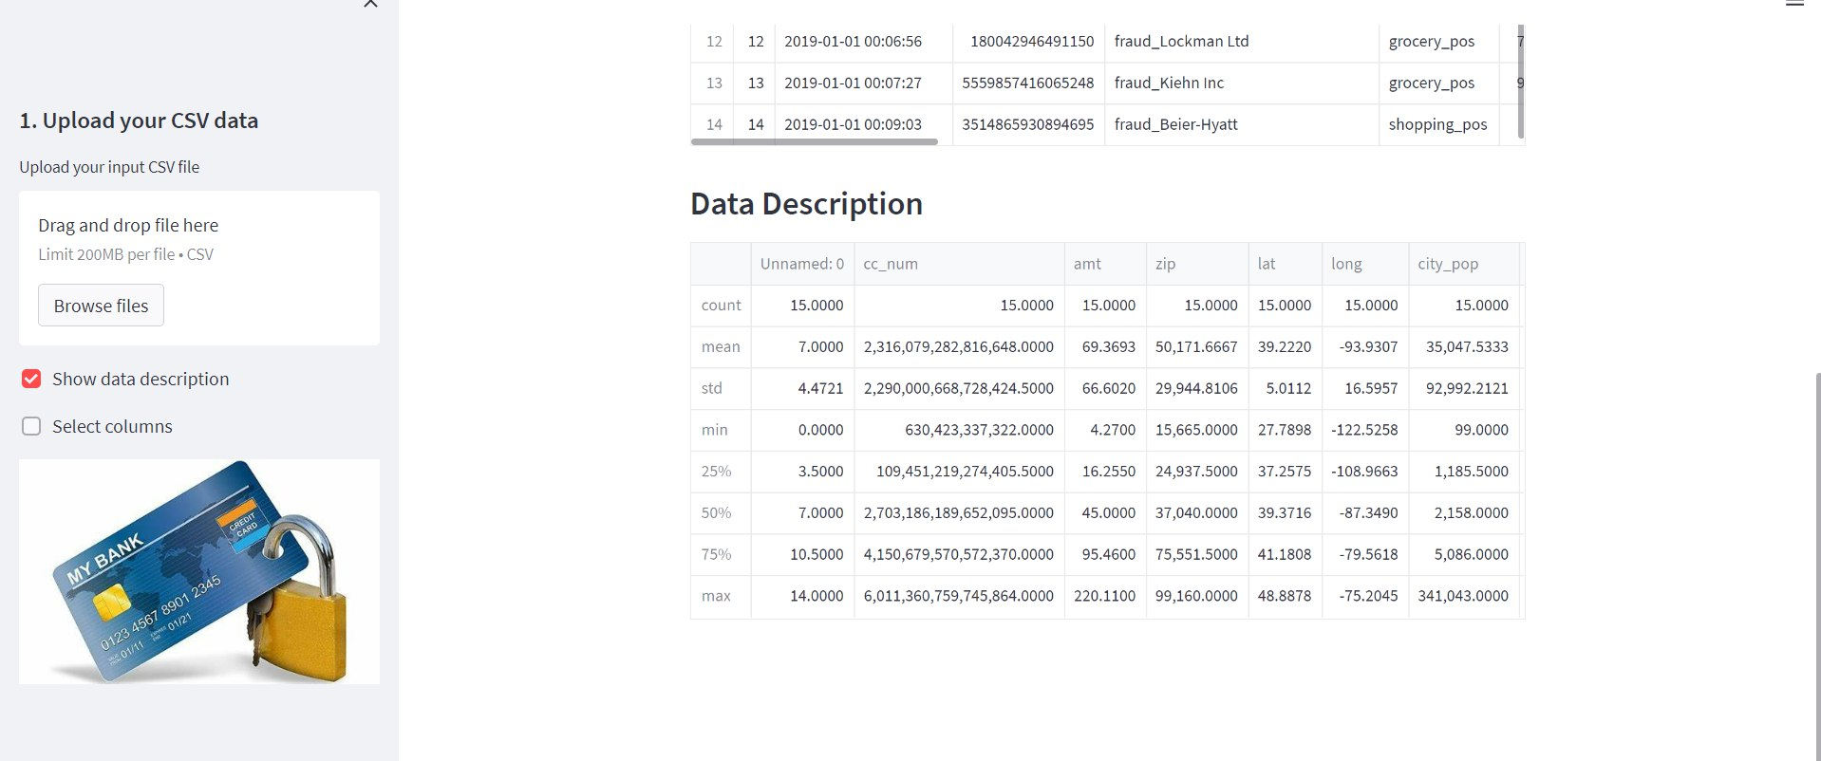

Slide 29
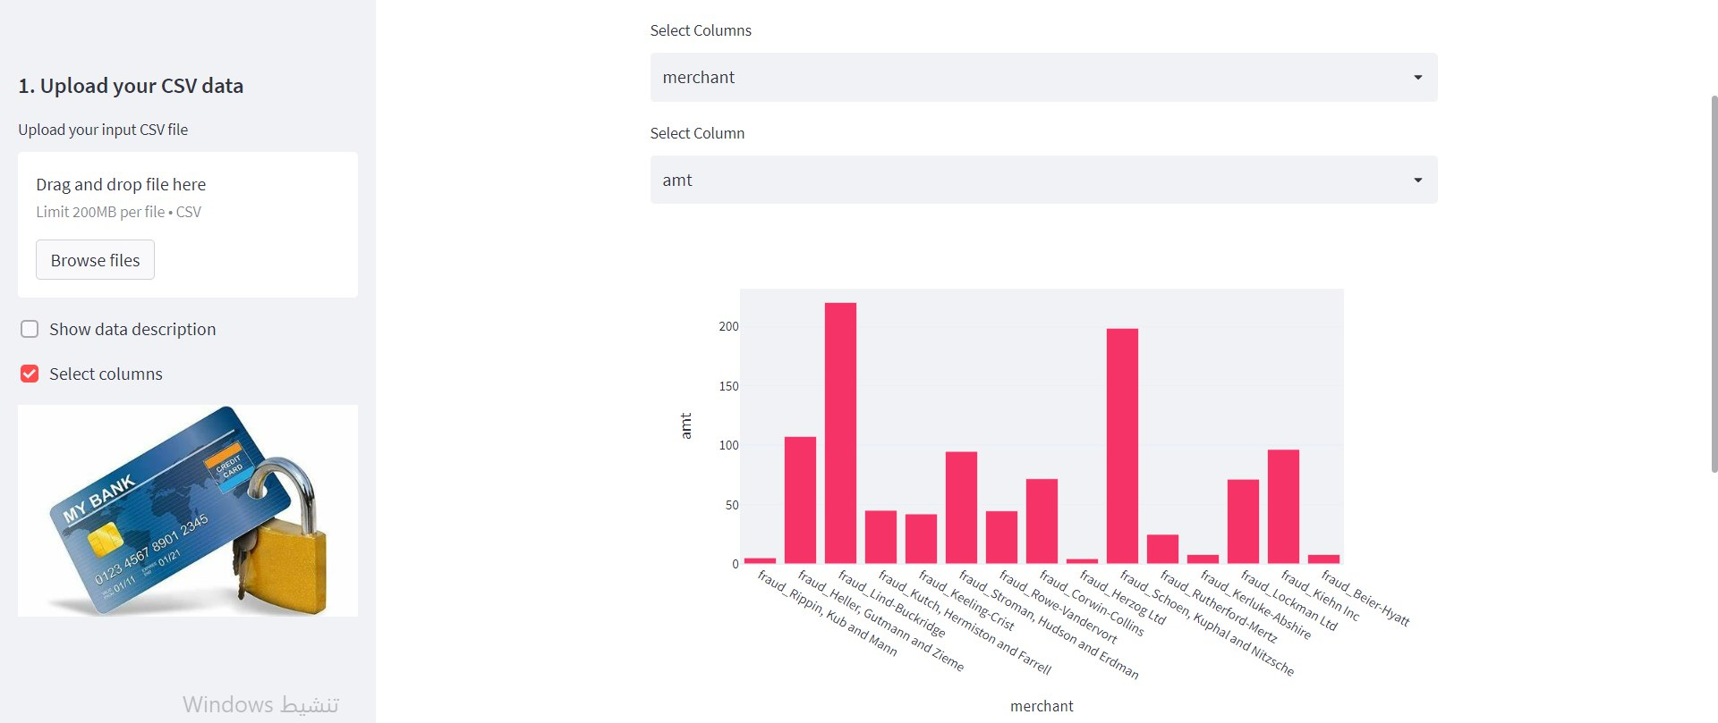

Slide 30
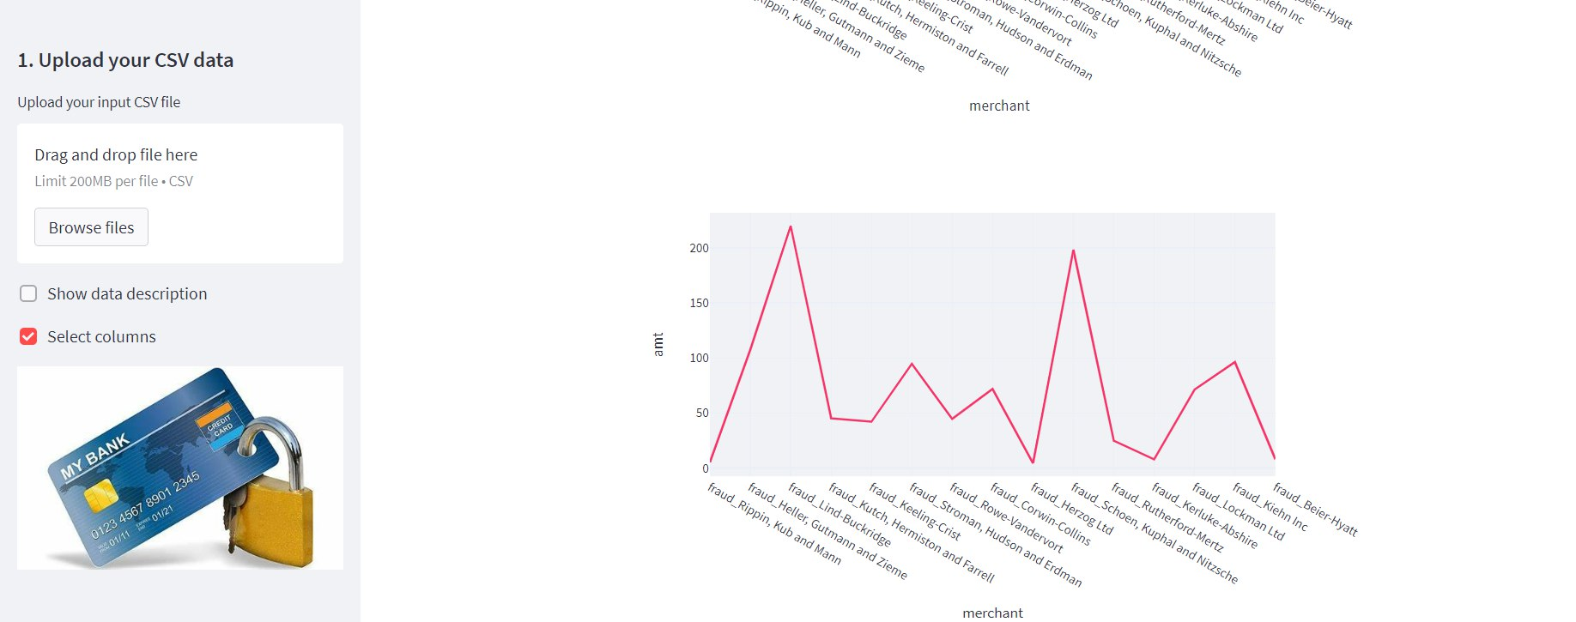

Slide 31
11
Difficulties and future
work
Difficulties
Standard dataset
Data balancing

Slide 32

Future work
automatic

Slide 33

Thank you
for your attention

